Slide 1



Python Tsunami
Installation and Tools
– June 7th-9th –

Slide 2
How do I work with Python?
Setting up Python
Virtual Environments
Jupyter Notebooks
Google Colab

Slide 3
How do I work with Python?
Setting up Python
Virtual Environments
Jupyter Notebooks
Google Colab

Slide 4

Setting up Python
Pros:
Your own local installation
Easy access to data stored locally
More control over installed versions
Not difficult if done right
Cons:
May require solving issues (sometimes obscure) if incorrectly installed
Each Operating System (Windows, MacOS, Linux, …) may require specific steps

Slide 5
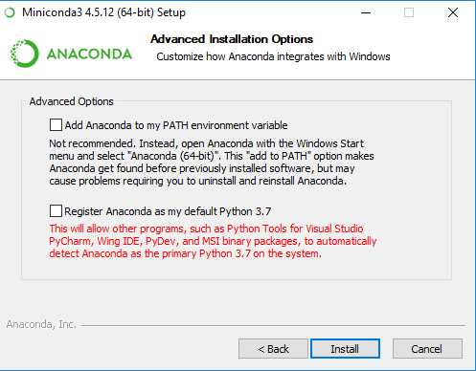
Setting up Python
Installation:
Miniconda: a free minimal installer for conda
an open source package management system that quickly installs, runs and updates packages and their dependencies. Runs on Windows, macOS and linux.
https://docs.conda.io/en/latest/miniconda.html
Find your Operating System
Download Python 3.8
Install it following the steps and make sure to check:

Slide 6
Setting up Python
Installation:
Miniconda: a free minimal installer for conda
an open source package management system that quickly installs, runs and updates packages and their dependencies. Runs on Windows, macOS and linux.
https://docs.conda.io/en/latest/miniconda.html
Find your Operating System
Download Python 3.8
Install it following the steps and make sure to check:

Slide 7

Virtual Environments
Python apps will often use packages and modules that are not part of the standard library
Apps sometimes need a specific version of a library
This means, one single Python installation may not meet the requirements of every application
The solution is to create a virtual environment, a self-contained directory that contains a Python installation (version) and the necessary packages
Pandas 1.0
App 1
Python 3.7
App 2
Pandas 0.25
App 3
Python 3.8
App 1
environment 1
Python 3.7
Pandas 1.0
App 2
Environment 2
Python 3.7
Pandas 0.25
App 3
Environment 3
Python 3.8
Pandas 0.25

Slide 8
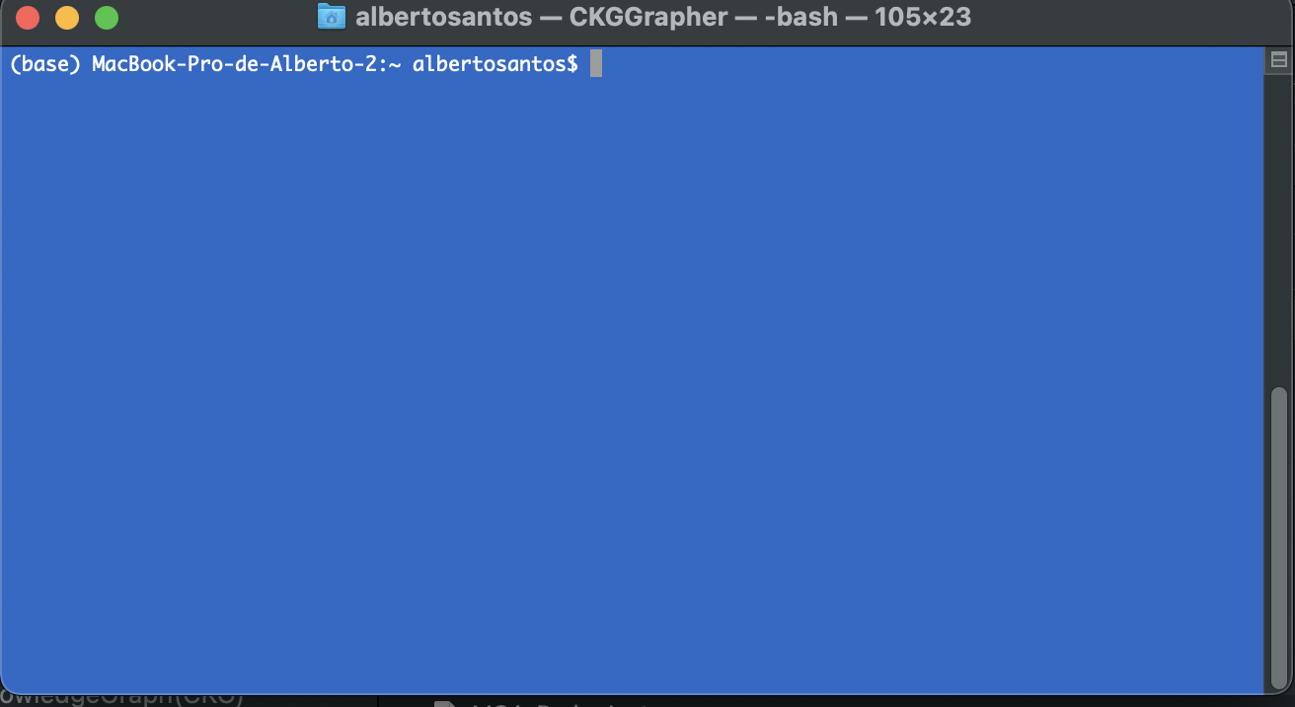
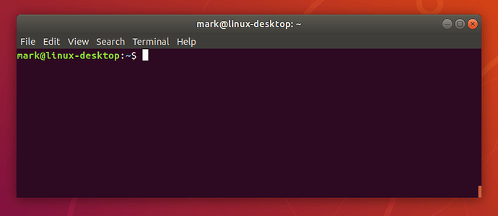
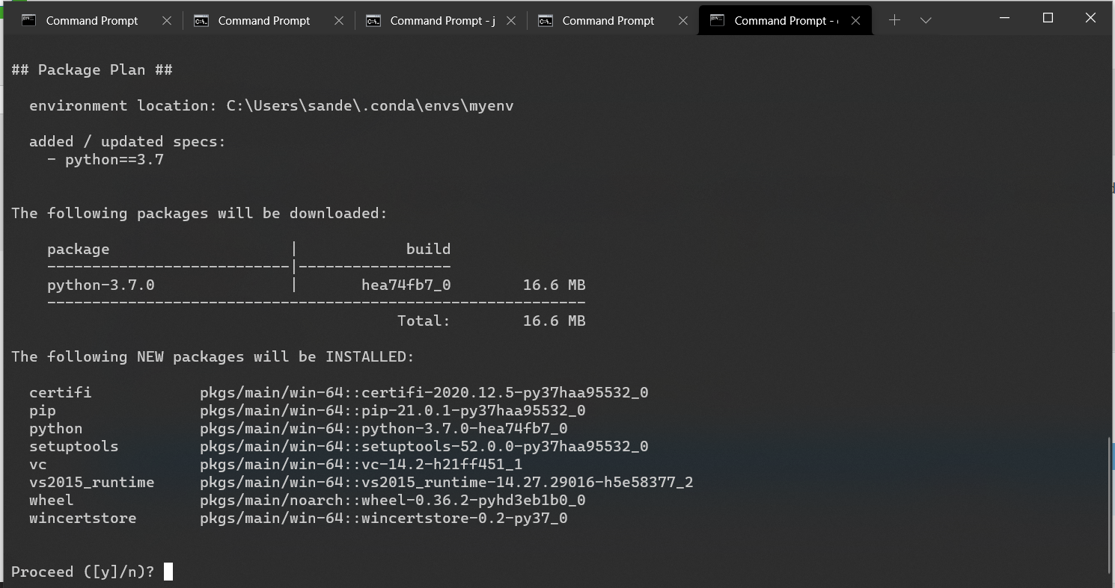
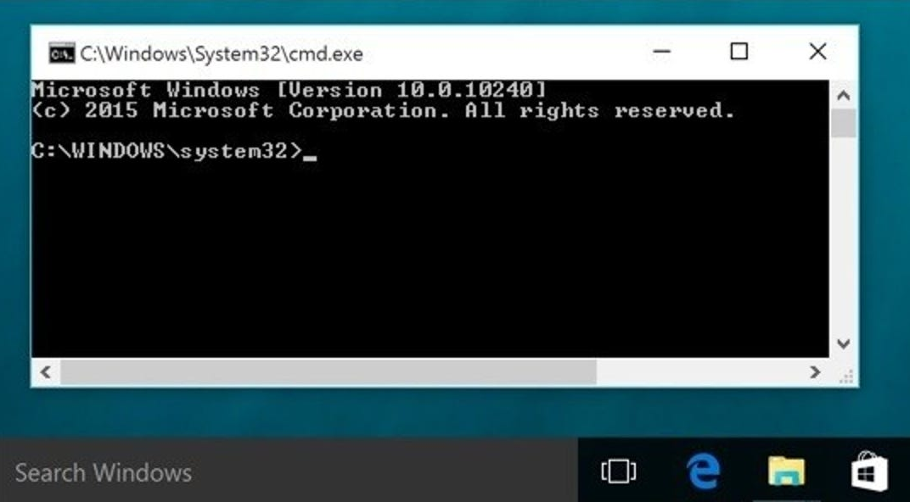
Virtual Environments
Let’s create a virtual environment:
To create an environment we use:
conda create -n name_env python==version
Open a Terminal window
Type conda create -n myenv python==3.7 and ‘y’
To activate the environment type:
conda activate myenv
Now, if we type python we have the right python version
App 1
environment 1
Python 3.7
Notes:
Basic python
Import library → error
Exit() and install library
A better way → environments

Slide 9
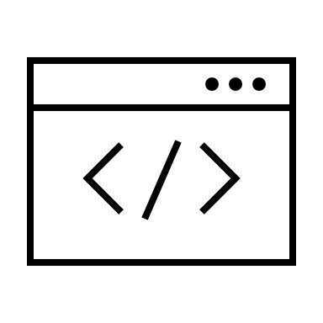



What tool do I use for coding?
Terminal → 2 options:
Shell: python
Interactive shell: ipython
Simple text editors:
Notepad++
Vim
Integrated development environments (IDEs) → Several options:
IDLE
PyCharm
Spyder
Visual Studio Code
Notebooks

Slide 10


Jupyter Notebooks
The Jupyter Notebook is an open-source application to create and share documents that contain code, equations, visualizations and text (markdown)

Slide 11
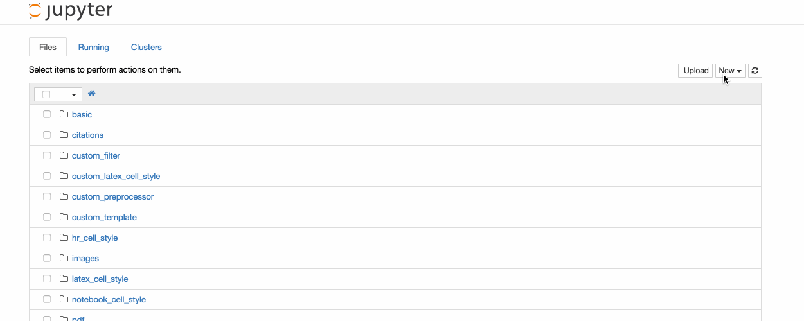
Jupyter Notebooks
Let’s install Jupyter Notebooks:
Open a Terminal window
Activate your environment:
conda activate myenv
Use pip to install Jupyter*:
pip install notebook
To start notebooks:
jupyter notebook
*This is where some OS may start complaining
Notes:
Basic python
Import library → error
Exit() and install library
A better way → environments

Slide 12


Google Colab
Colab (Colaboratory) is a tool to write, execute and share python code through the browser
Colab is especially well suited to machine learning, data analysis and education.
Colab is a hosted Jupyter notebook service that requires no setup to use, while providing free access to computing resources including GPUs
It is connected to a Google account and data can be accessed through Google Drive.
https://colab.research.google.com/

Slide 13





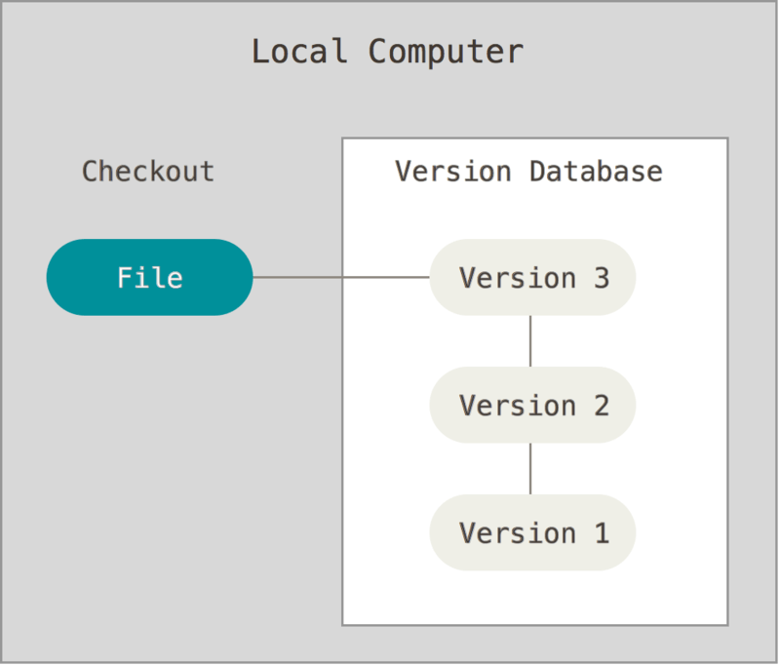


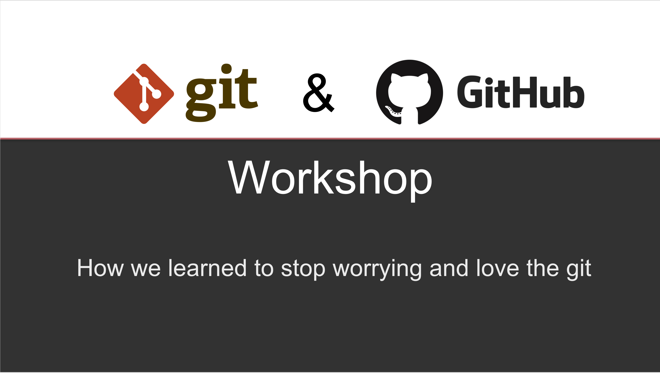
Taking Control of Your Code
manuscript_draft.doc
manuscript_draft2.doc
manuscript_draft3.doc
manuscript_final1.doc
manuscript_final33_mod_JADH_GGS_final44_reviewed_FH_2.2.1.doc
Version control
It is a system that records changes to a file or set of files over time so that you can recall specific versions (history)
Important in coding, especially when the code is accessed by “many” people (>1)
A good way to share your code with others
Git is a software for tracking changes and coordinating work among collaborators developing code
GitHub facilitates access to Git’s functionality
Recommended
https://github.com/Center-for-Health-Data-Science/PythonTsunami

Slide 14



